Slide 1

Anomaly Detection

Slide 2
ISOLATION FOREST
Notes:
Şafak

Slide 3
Isolation Forest: Motivation
The Isolation Forest “isolates” observations by randomly selecting a feature and then randomly selecting a split value between the maximum and minimum values of the selected feature. iForest utilizes no distance or density measures to detect anomalies.
İsolation means ‘separating an instance from the rest of the instances’. Since anomalies are “few and different” and therefore they are more susceptible to isolation. This random partitioning produces noticeable shorter paths for anomalies:
The fewer instances of anomalies result in a smaller number of partitions – shorter paths in a tree structure
Instances with distinguishable attribute-values are more likely to be separated in early partitioning.
Hence, when a forest of random trees collectively produce shorter path lengths for some particular points, then they are highly likely to be anomalies.
Notes:
Şafak

Slide 4
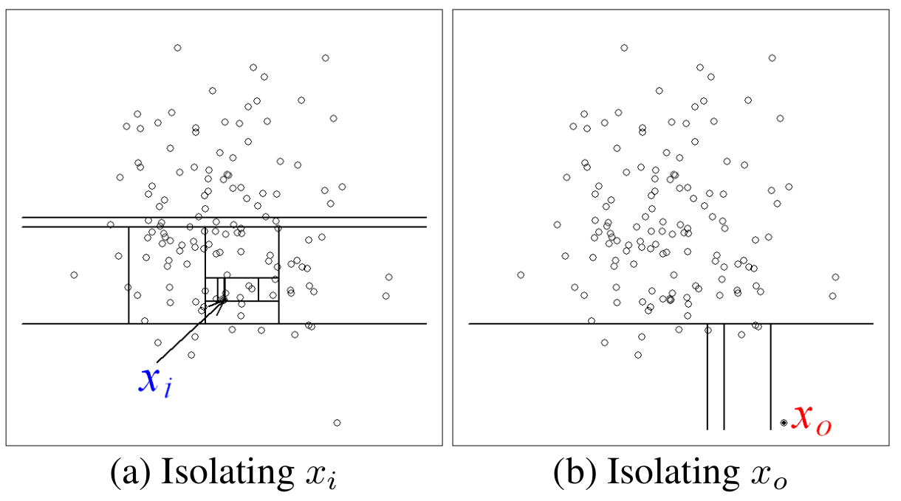
Isolation Forest: Motivation
Normal point, x_{i}, generally requires more partitions to be isolated. The opposite is also true for the anomaly point, x_{o}, which generally requires less partitions to be isolated. In this example, partitions are generated by randomly selecting an attribute and then randomly selecting a split value between the maximum and minimum values of the selected attribute.
Since each partition is randomly generated, individual trees are generated with different sets of partitions. We average path lengths over a number of trees to find the expected path length. Using 1000 trees, the average path lengths of x_{o} and x_{i} converge to 4.02 and 12.82 respectively. It shows that anomalies are having path lengths shorter than normal instances.
Notes:
Şafak

Slide 5

Isolation Forest: Definition
Let h(x) is the path length of point x, which is measured by the number of edges x traverses an iTree from the root node until the traversal is terminated at an external node. There should be a anomaly score to detect anomalies. The difficulty in deriving such a score from h(x) is that while the maximum possible height of iTree grows in the order of n, the average height grows in the order of log n asymptotically. So, normalization of h(x) by any of the above terms is neither bounded nor can be directly compared.
Since iTrees have an equivalent structure to Binary Search Tree (BST), the estimation of average h(x) for external node terminations is the same as the unsuccessful search in BST. Given a data set of n instances, average path length of unsuccessful search in BST as:
Where H(i) is the harmonic number (ln(i) + 0.5772156649).
Notes:
Şafak

Slide 6
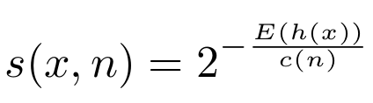
Isolation Forest: Definition
As c(n) is the average of h(x) given n, we use it to normalize h(x). The anomaly score s of an instance x is defined as:
Where E[h(x)] is the expected value of h(x) from a collection of isolation trees. In this equation s is monotonic to h(x).
If instances return s very close to 1, then they are definitely anomalies.
If instances have s much smaller than 0.5, then they are quite safe to be regarded as normal instances.
If all the instances return s ≈ 0.5, then the entire sample does not really have distinct anomaly.
Explanations & images are taken from original paper. Read for more details.
Notes:
Şafak

Slide 7
LOCAL OUTLIER FACTOR
Notes:
Şafak

Slide 8
Local Outlier Factor: Motivation
The local outlier factor is based on a concept of a local density, where locality is given by k nearest neighbors, whose distance is used to estimate the density.
By comparing the local density of an object to the local densities of its neighbors, one can identify regions of similar density, and points that have a substantially lower density than their neighbors. These are considered to be outliers.
Notes:
Şafak

Slide 9
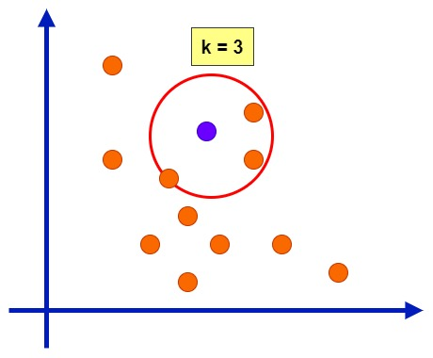
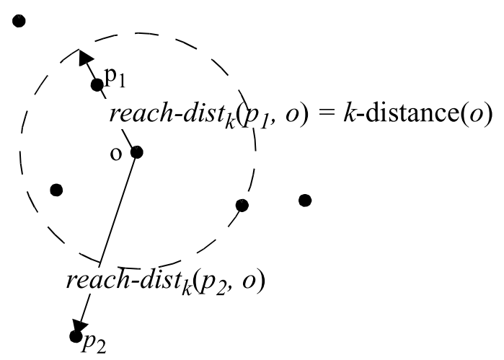
Local Outlier Factor
K-distance is based on neighborhood style distance calculation. The distances of a point A to its neighbors are calculated, and if these distances are ordered from smallest to largest, the kth distance gives us the k-distance.
Let k be a natural number. The reachability distance of object p with respect to object o is defined as:
reach-dist_{k}(p, o) = max{k-distance(o), d(p,o)}
Notes:
Şafak

Slide 10
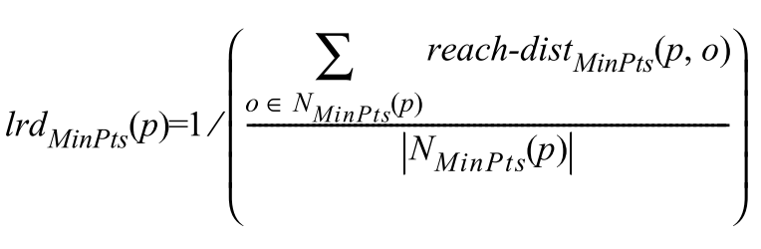
Local Outlier Factor
Intuitively, the local reachability density of an object p is the inverse of the average reachability distance based on the MinPts-nearest neighbors of p.
Notes:
Şafak

Slide 11
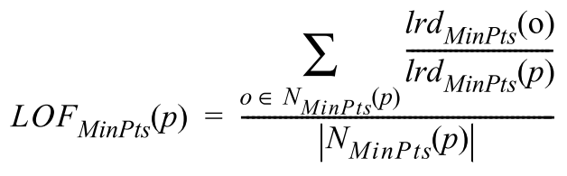
Local Outlier Factor
The outlier factor of object p captures the degree to which we call p an outlier. It is the average of the ratio of the local reachability density of p and those of p’s MinPts-nearest neighbors. LOF generates a score for each point. A value below 1 indicates a denser region, while values ​​significantly greater than 1 indicate outliers.
Notes:
Şafak

Slide 12
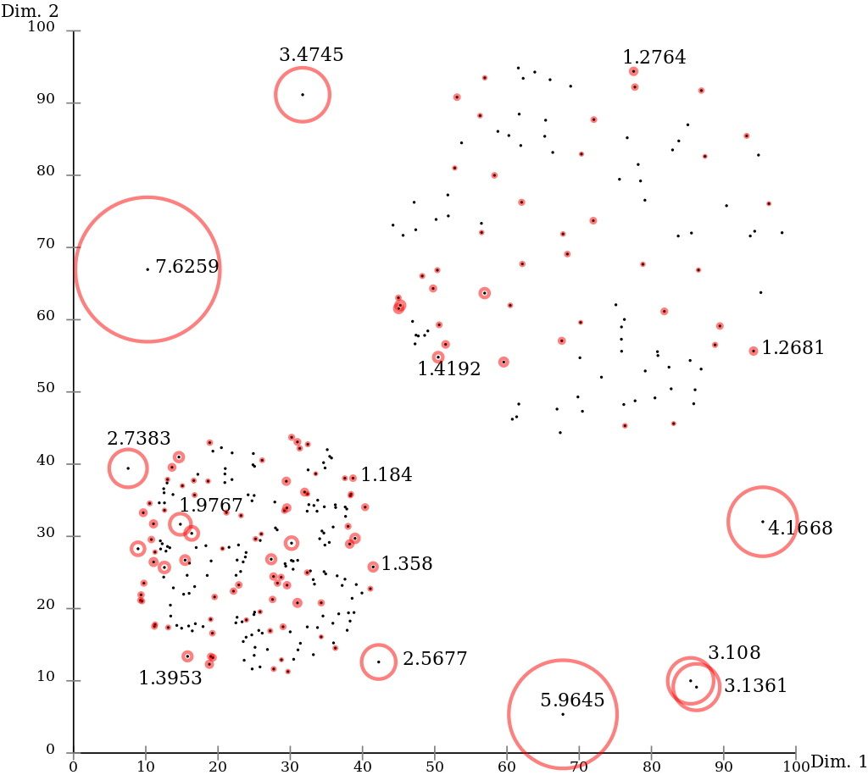
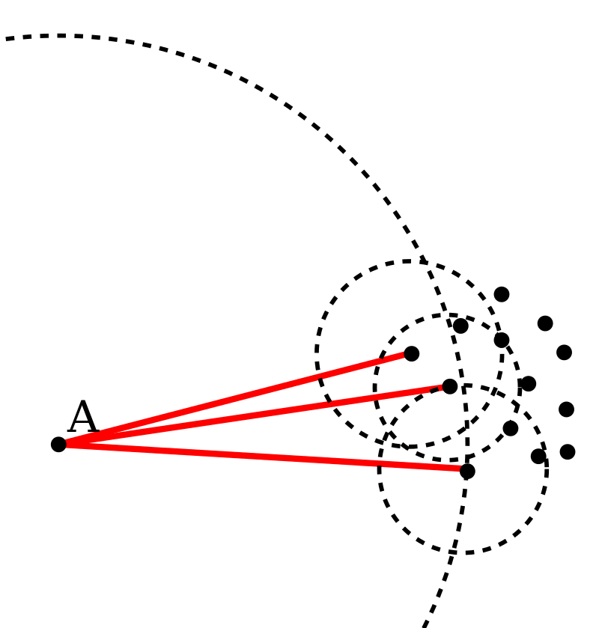
Local Outlier Factor
Explanations & images are taken from original paper and wikipedia page. See for more details.
Notes:
Şafak

Slide 13
AUTOENCODERS
Notes:
Şafak

Slide 14
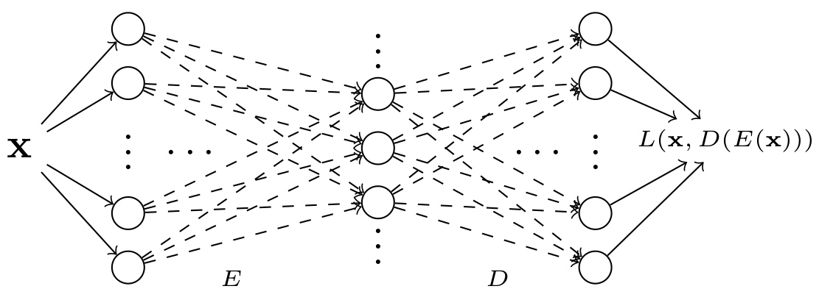
Autoencoders: Motivation
Autoencoders are an unsupervised learning architectures in neural networks. They are commonly used in Deep Learning tasks; such as generative models, anomaly detection, dimensionality reduction. They map the input data into lower dimensional space with encoder E, and then maps into same space that have same dimension of input data with decoder D. The main idea behind Autoencoders is to attempt to copy its input to its output. The input layer is fed with input vector x and the loss is calculated at output layer between x and E(D(x)), in other words the loss is L(x, E(D(x))). It measures difference between our original input and the consequent reconstruction. We named the middle layer, that is connection between encoder E and decoder D, as the ”bottleneck”.
Notes:
Şafak

Slide 15
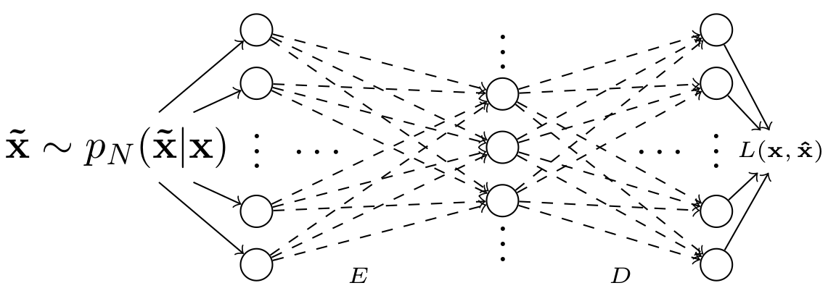
Autoencoders: Denoising Auto Encoders
When we said that main idea behind autoencoders is to copy input to its output, the key idea is that not to copy without extracting useful informations about the distribution of the data. Autoencoders are allowed too much capacity, easy to be trained to the copying the task with learning anything useful about the dataset. So we need to penalize those autoencoders. We can achieve the task that learning useful informations about data by adding some noise to input data. To perform the denoising, the input x is corrupted into x̃ through stochastic mapping of x̃ ∼ p_{N}(x̃|x). Then the noisy (corrupted) input is used for encoding and decoding parts.
Notes:
Şafak

Slide 16
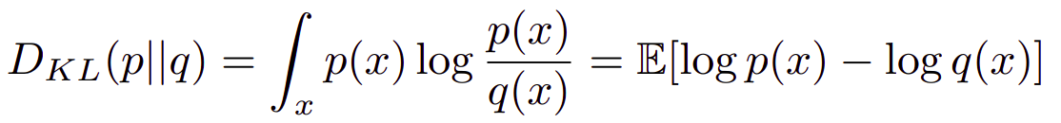
Autoencoders: VAE
Variational Autoencoder (VAE) is a deep learning technique for learning latent representations. VAE also can be used for generative tasks. It allows model to learn complex distributions from complex datasets. The motivation behind Variational Autoencoders is to produce a output distribution which is equivalent to the input distribution. The probabilistic encoder p_{encoder}(z|x) of VAE learns representing input with lower-dimensional space. The probabilistic decoder p_{decoder}(x|z) of VAE learns reconstructing the input from lower-dimensional representation. The objective function of
VAE is combination of Kullback Leibler Divergence (KL Divergence) loss and log-likelihood loss. It allows model to approximate its posterior p_{decoder}(x|z) to normal distribution prior p(z):
Notes:
Şafak

Slide 17
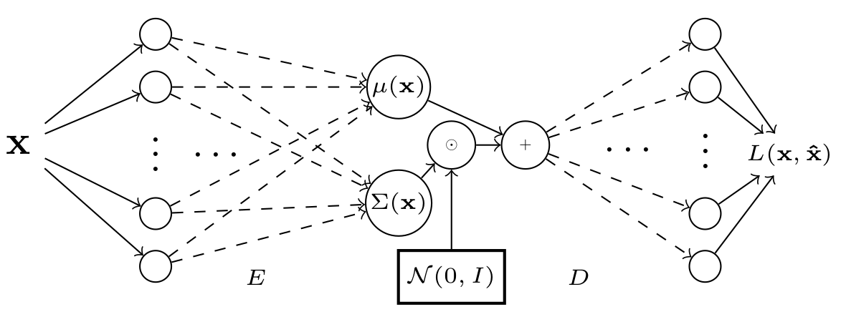
Autoencoders: VAE
Notes:
Şafak

Slide 18
BOOSTING ALGORITHMS
Notes:
Şafak

Slide 19
XGBoost
General Parameters: booster [default=gbtree], silent [default=0], nthread
Booster Parameters: eta [default=0.3], min_child_weight [default=1], max_depth [default=6], max_leaf_nodes
Learning Task Parameters: objective [default=reg:linear], eval_metric [ default according to objective ], seed [default=0]
Notes:
Şafak

Slide 20
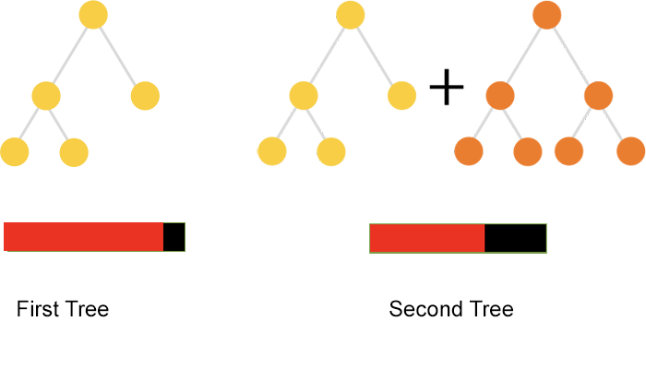
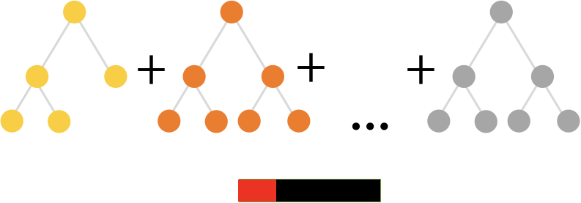
CatBoost
iterations, random_strength, max_depth, max_leaves, one_hot_max_size, task_type …
Notes:
Şafak

Slide 21
REFERENCES
Notes:
Şafak

Slide 22
F. T. Liu, K. M. Ting and Z. Zhou, "Isolation Forest," 2008 Eighth IEEE International Conference on Data Mining, 2008, pp. 413-422, doi: 10.1109/ICDM.2008.17.
Breunig, Markus & Kriegel, Hans-Peter & Ng, Raymond & Sander, Joerg. (2000). LOF: Identifying Density-Based Local Outliers.. ACM Sigmod Record. 29. 93-104. 10.1145/342009.335388.
Wikipedia contributors. (2021, July 12). Local outlier factor. In Wikipedia, The Free Encyclopedia. Retrieved 11:56, July 24, 2021, from https://en.wikipedia.org/w/index.php?title=Local_outlier_factor&oldid=1033189240
Jaan Altosaar. Understanding Variational Autoencoders from two perspectives: deep learning and graphical models. https://jaan.io/what-is-variational-autoencoder-vae-tutorial/
Carl Doersch. Tutorial on Variational Autoencoders. 2016. arXiv: 1606.05908 [stat.ML].
Ian Goodfellow, Yoshua Bengio, and Aaron Courville. Deep Learning. http://www.deeplearningbook.org. MIT Press, 2016.
Diederik P Kingma and Max Welling. Auto-Encoding Variational Bayes. 2014. arXiv: 1312.6114 [stat.ML].
Notes:
Şafak

